Slide 1
How to survive homework

Slide 2
school is a beautiful part of our lives because we meet new friends.
it is important to have friends, because without friends you cannot do anything.
don't do bad things, do what is good for you.
be active in class and do homework.
if you need help, ask a teacher or a friend.
if you have a lot of homework, you can leave something for the weekend. That's not a problem.

Slide 3
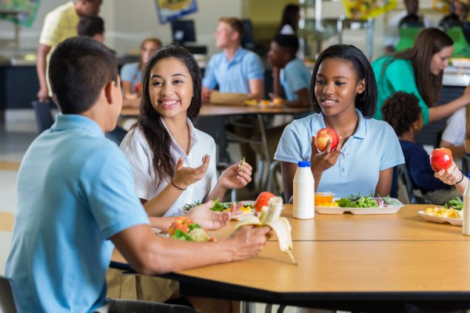
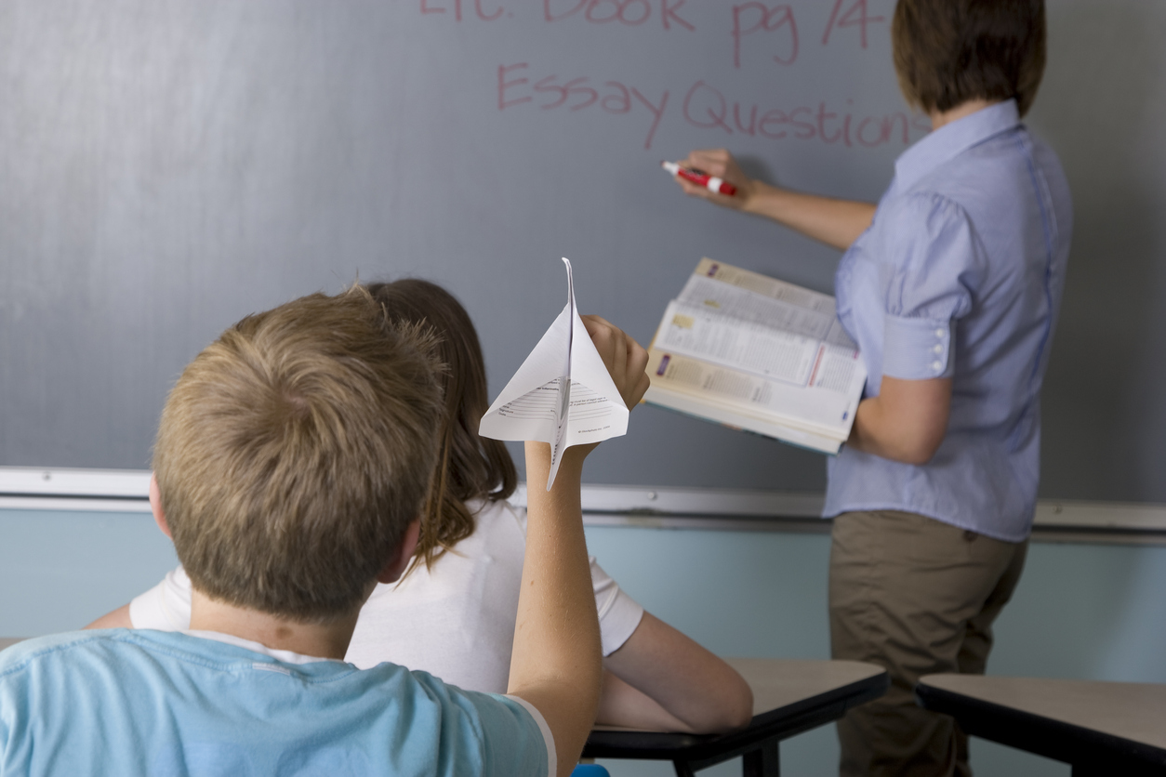

Slide 4
Thank you for your attention!

